Slide 1
Backpropagation and Grading Descent

Slide 2
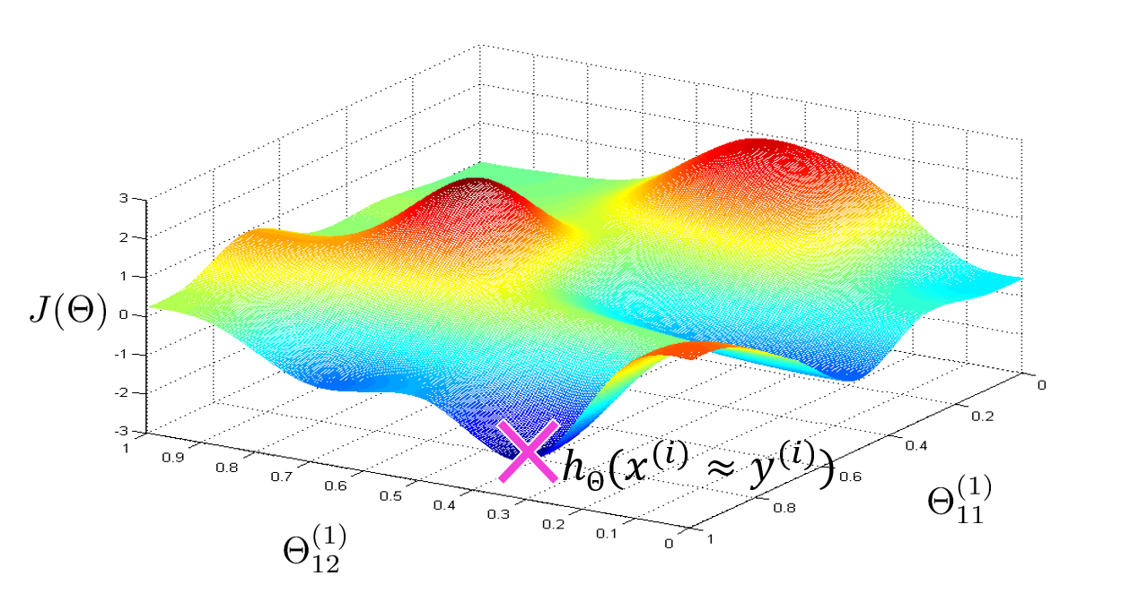
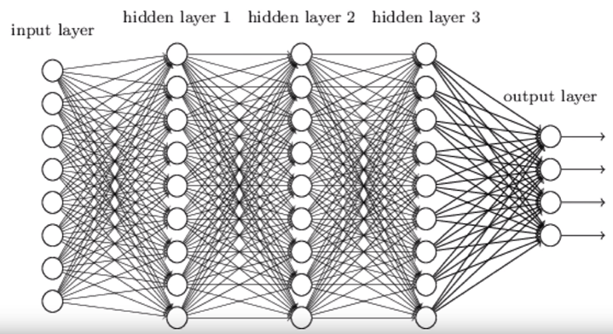
Updating the network weights
Given an individual weight coefficient in the network, how can you compute whether the coefficient should be increased or decreased, and by how much in order for the network to generate better predictions?
One naive solution would be to freeze all weights in the network except the one scalar coefficient being considered, and try different values for this coefficient.
Let’s say the initial value of the coefficient is 0.3. After the forward pass on a batch of data, the loss of the network on the batch is 0.5. If you change the coefficient’s value to 0.35 and rerun the forward pass, the loss increases to 0.6. But if you lower the coefficient to 0.25, the loss falls to 0.4. In this case, it seems that updating the coefficient by -0.05 would contribute to minimizing the loss. This would have to be repeated for all coefficients in the network.
But such an approach would be horribly inefficient, because you’d need to compute two forward passes (which are expensive) for every individual coefficient (of which there are many, usually thousands and sometimes up to millions) for each training example.
A much better approach is to take advantage of the fact that all operations used in the network are differentiable, and compute the gradient (derivative) of the loss with respect to the network’s coefficients. You can then move the coefficients in the opposite direction from the gradient, thus decreasing the loss.

Slide 3
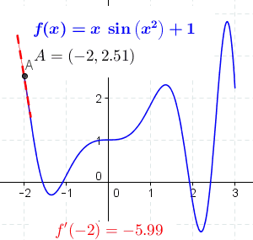
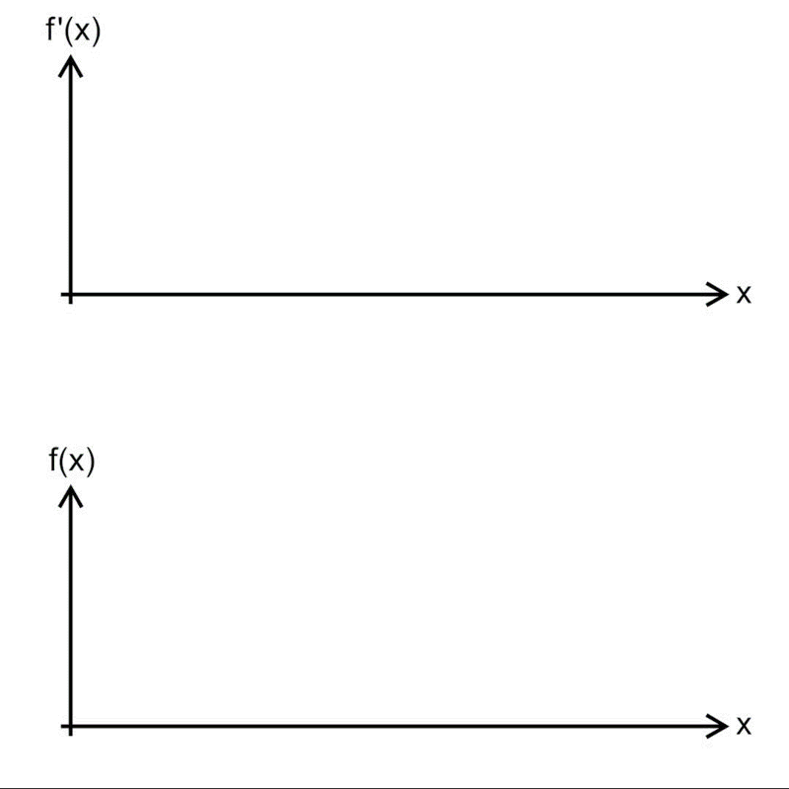
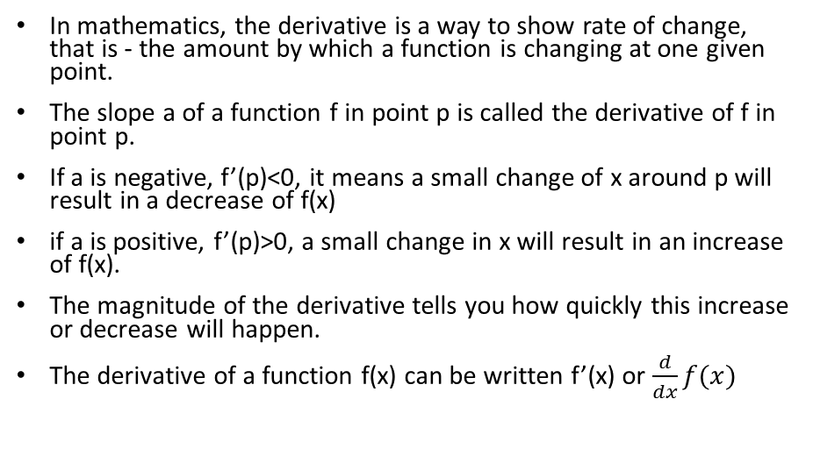
The derivative
In mathematics, the derivative is a way to show rate of change, that is - the amount by which a function is changing at one given point.
The slope a of a function f in point p is called the derivative of f in point p.
If a is negative, f’(p)<0, it means a small change of x around p will result in a decrease of f(x)
if a is positive, f’(p)>0, a small change in x will result in an increase of f(x).
The magnitude of the derivative tells you how quickly this increase or decrease will happen.
The derivative of a function f(x) can be written f’(x) or $\frac{d}{dx}f(x)$
p

Slide 4

Derivative of a tensor operation: the gradient
A gradient is the derivative of a tensor operation. It’s the generalization of the concept of derivatives to functions of multidimensional inputs: that is, to functions that take tensors as inputs.
Consider an input vector x, a matrix W, a target y, and a loss function J. You can use W to compute a target candidate y_pred, and compute the loss, or mismatch, between the target candidate y_pred and the target y
y_pred = dot(W, x)
loss_value = J(y_pred, y)
If the data inputs x and y are frozen, then this can be interpreted as a function mapping values of W to loss values:
loss_value = f(W)

Slide 5
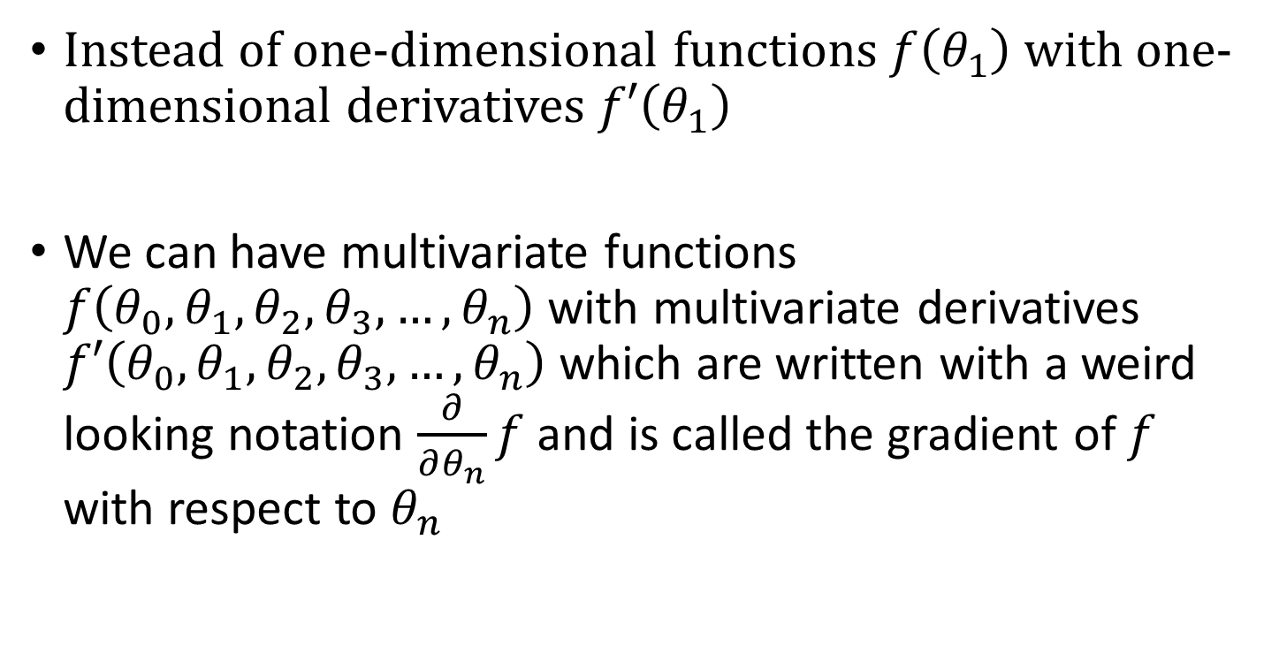
Derivatives in higher dimensional space
Instead of one-dimensional functions $f\left(θ_{1}\right)$ with one-dimensional derivatives $f′\left(θ_{1}\right)$
We can have multivariate functions $f\left(θ_{0},θ_{1},θ_{2},θ_{3},…,θ_{n}\right)$ with multivariate derivatives $f′\left(θ_{0},θ_{1},θ_{2},θ_{3},…,θ_{n}\right)$ which are written with a weird looking notation $\frac{∂}{∂θ_{n}}f$ and is called the gradient of $f$ with respect to $θ_{n}$

Slide 6
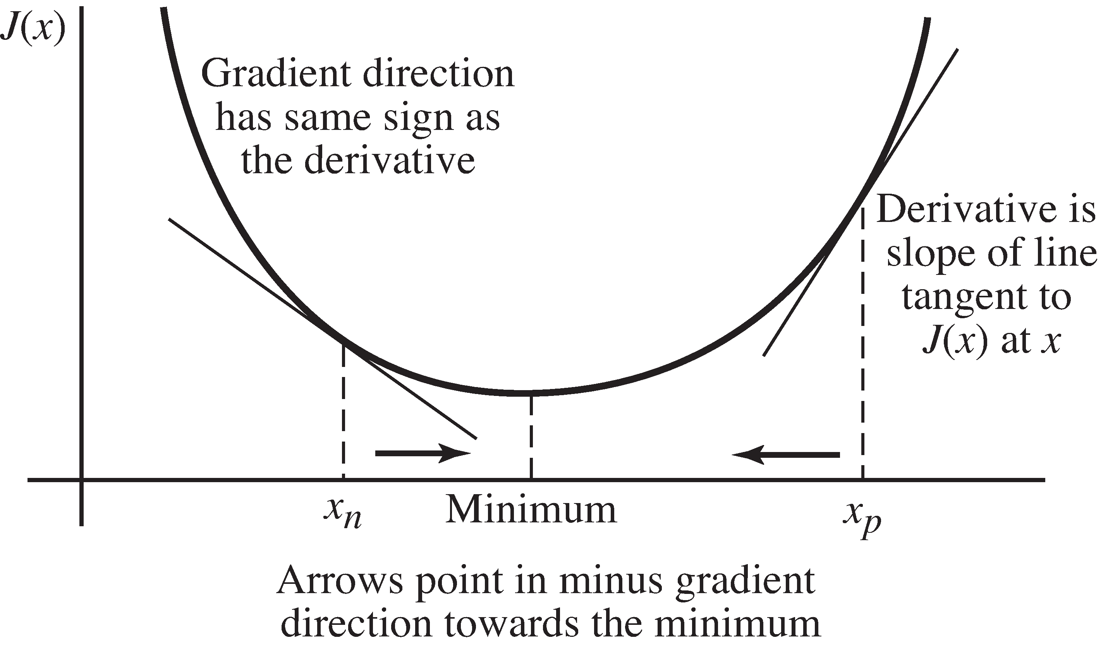
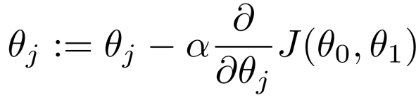
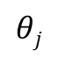
Gradient descent parameter update intuition
Learning Rate
$$θj$$

Slide 7
Grading descent
The following figure illustrates what happens in 1D, when the network has only one parameter
The following figure illustrates what happens in 2D, when the network has 2 parameters

Slide 8
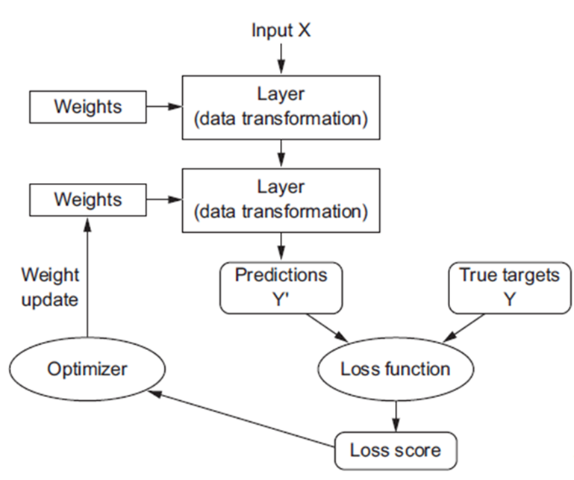
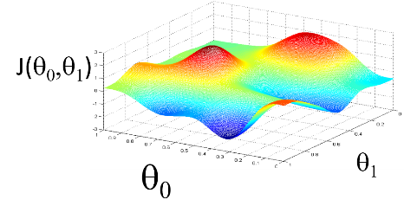
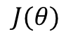
Stochastic gradient descent (SGD)
Gradient descent is basically:
Draw a batch of training samples X and corresponding targets Y
Run a forward pass on the network for X to obtain predictions Y’
Compute the loss function of the network on the batch, a measure of the mismatch between Y’ and Y.
Compute the gradient of the loss with regard to the network’s parameters (a backward pass).
Move the parameters a little in the opposite direction from the gradient—for example W -= step * gradient—thus reducing the loss on the batch a bit.
$$J(θ)$$

Slide 9
Other optimizers
There exist multiple variants of SGD that differ by taking into account previous weight updates when computing the next weight update, rather than just looking at the current value of the gradients.
There is, for instance,
SGD with momentum
RMSProp
Adam
and several others.
Such variants are known as optimization methods or optimizers.

Slide 10
Backpropagation is the implementation of grading descent in neural networks
In practice, a neural network function consists of many tensor operations chained together, each of which has a simple, known derivative.
For instance, this is a network f composed of three tensor operations, a, b, and c, with weight matrices W1, W2, and W3:
f(W1, W2, W3) = a(W1, b(W2, c(W3)))
Calculus tells us that such a chain of functions can be derived using the following identity, called the chain rule
f(g(x)) = f'(g(x)) * g'(x).
Applying the chain rule to the computation of the gradient values of a neural network gives rise to an algorithm called backpropagation

Slide 11
Backpropagation
Backpropagation starts with the final loss value and works backward from the top layers to the bottom layers, applying the chain rule to compute the contribution that each parameter had in the loss value.
Nowadays, and for years to come, people will implement networks in modern frameworks that are capable of symbolic differentiation, such as TensorFlow.
This means that, given a chain of operations with a known derivative, they can compute a gradient function for the chain (by applying the chain rule) that maps network parameter values to gradient values. When you have access to such a function, the backward pass is reduced to a call to this gradient function.
Thanks to symbolic differentiation, you’ll never have to implement the Backpropagation algorithm by hand.

Slide 12
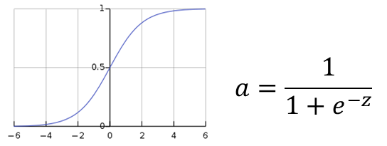
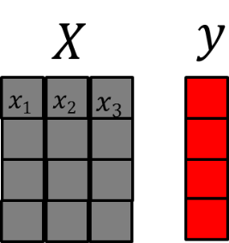
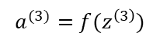
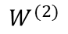
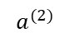
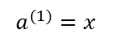
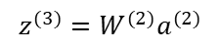
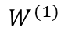
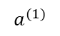
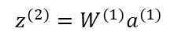
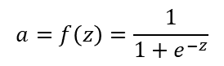
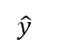
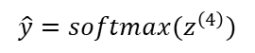
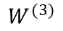
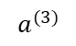
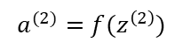
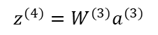
Forward propagation:
$$a=f\left(z\right)=\frac{1}{1+e^{−z}}$$
$$W^{(1)}$$
$$W^{(2)}$$
$$W^{(3)}$$
$$a^{(1)}=x^{}$$
$$z^{(2)}=W^{(1)}a^{(1)}$$
$$a^{(2)}=f(z^{\left(2\right)})$$
$$a^{(2)}$$
$$a^{(3)}$$
$${\hat{y}}^{}$$
$$z^{(3)}=W^{(2)}a^{(2)}$$
$$a^{(1)}$$
$$a^{(3)}=f(z^{\left(3\right)})$$
$$z^{(4)}=W^{(3)}a^{(3)}$$
$$\hat{y}=softmax(z^{\left(4\right)})$$
$$h_{W}\left(x\right)=\hat{y}=f(W^{(3)}f(W^{(2)}f(W^{(1)}x)))$$
Layer 1
(input layer)
Layer 2
Layer 3
Layer 4
(output layer)

Slide 13
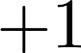
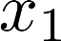
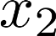
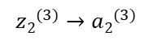
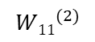
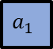
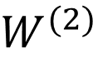
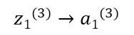
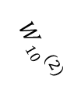
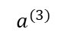
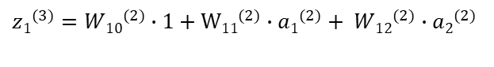
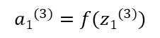

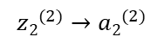
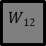
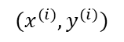
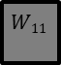
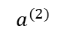
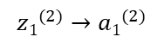
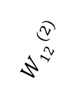
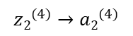
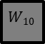

$$W^{(2)}$$
$$a^{(2)}$$
$$W10$$
$$W11$$
$$W12$$
$$a^{(3)}$$
1
$$a_{1}$$
$$a_{2}$$
1
$$a_{1}$$
$$a_{2}$$
Forward Propagation
$${W10}^{(2)}$$
$${z1}^{(2)}→{a1}^{(2)}$$
$${W11}^{(2)}$$
$${z1}^{(3)}→{a1}^{(3)}$$
$${z2}^{(4)}→{a2}^{(4)}$$
$${W12}^{(2)}$$
$${z2}^{(2)}→{a2}^{(2)}$$
$${z2}^{(3)}→{a2}^{(3)}$$
$$(x^{(i)},y^{(i)})$$
${z1}^{(3)}={W10}^{(2)}∙1+$ $W{11}^{(2)}∙{a1}^{(2)}+ {W12}^{(2)}∙{a2}^{(2)}$
$${a1}^{(3)}=f({z1}^{(3)})$$

Slide 14














Backpropagation
Back propagation of error signals $δ^{(n)}$
$$δ^{(1)}$$
$$δ^{(2)}$$
$$δ^{(3)}$$
$$δ^{(4)}$$
$${W10}^{(2)}$$
$${z1}^{(2)}→{a1}^{(2)}$$
$${W11}^{(2)}$$
$${z1}^{(3)}→{a1}^{(3)}$$
$${z2}^{(4)}→{a2}^{(4)}$$
$${W12}^{(2)}$$
$$J\left(W\right)=δ^{(4)}=y−{a2}_{}^{(2)}$$
$${z2}^{(2)}→{a2}^{(2)}$$
$${z2}^{(3)}→{a2}^{(3)}$$
$δ$ “error” or cost: discrepancy between actual target y and network prediction

Slide 15






The parameter optimization process in an artificial neural network (back propagation) is basically gradient descent
$$hΘ(x^{\left(i\right)}≠ y^{(i)})$$
$$hΘ(x^{(i)}≈y^{(i)})$$

Slide 16

Overfitting (high variance) and underfitting (high bias)
The fundamental issue in machine learning is the tension between optimization and generalization.
Optimization refers to the process of adjusting a model to get the best performance possible on the training data
Generalization refers to how well the trained model performs on data it has never seen before
The goal of the game is to get good generalization
At the beginning of training, optimization and generalization are correlated: while this is happening, your model is said to underfit: there is still progress to be made; the network hasn’t yet modeled all relevant patterns in the training data.
But after a certain number of iterations on the training data, generalization stops improving, and validation metrics stall and then begin to degrade: the model is starting to overfit.
That is, it’s beginning to learn patterns that are specific to the training data but that are misleading or irrelevant when it comes to new data.
To prevent a model from learning misleading or irrelevant patterns found in the training data, the best solution is to get more training data.
When that isn’t possible, the next-best solution is to modulate the quantity of information that your model is allowed to store or to add constraints on what information it’s allowed to store.
The processing of fighting overfitting this way is called regularization.

Slide 17
Overfitting
In deep learning we try to use complex/flexible/deep models that will capture complex patterns
We can use several techniques to prevent overfitting
Early termination
Reducing the network size
Regularization
Dropout
Get more training data

Slide 18

Techniques to prevent overfitting 1. Early termination

Slide 19
Techniques to prevent overfitting 2. Reducing the networks size
The simplest way to prevent overfitting is to reduce the size of the model:
the number of learnable parameters in the model (which is determined by the number of layers and the number of units per layer).
Intuitively, a model with more parameters has more memorization capacity/flexibility and therefore can easily learn a perfect dictionary-like mapping between training samples and their targets
But such a model could be useless for classifying new samples
If the network has limited memorization resources, it won’t be able to learn this mapping as easily; thus, in order to minimize its loss, it will have to resort to learning compressed representations that have predictive power regarding the targets
At the same time, keep in mind that you should use models that have enough parameters that they don’t underfit: your model shouldn’t be starved for memorization resources.
There is a compromise to be found between too much capacity and not enough capacity (bias/variance trade-off).
Notes:
Unfortunately, there is no magical formula to determine the right number of layers
or the right size for each layer. You must evaluate an array of different architectures
(on your validation set, not on your test set, of course) in order to find the
correct model size for your data. The general workflow to find an appropriate model
size is to start with relatively few layers and parameters, and increase the size of the layers
or add new layers until you see diminishing returns with regard to validation loss.

Slide 20

Techniques to prevent overfitting 3. weight regularization (weight shrinkage)
You may be familiar with the principle of Occam’s razor:
given two explanations for something, the explanation most likely to be correct is the simplest one—the one that makes fewer assumptions
This idea also applies to the models learned by neural networks:
given some training data and a network architecture, multiple sets of weight values (multiple models) could explain the data
Simpler models (smaller values of parameters $θ$) are less likely to overfit than complex ones

Slide 21

Techniques to prevent overfitting 3. weight regularization (weight shrinkage)
A simple model in the context of machine learning is a model where the distribution of parameter values take only small values, which makes the distribution of weight values more regular
This is called weight regularization, and it’s done by adding to the loss function of the network a cost associated with having large weights
This cost comes in two flavors:
L1 regularization—The cost added is proportional to the absolute value of the weight coefficients (the L1 norm of the weights).
L2 regularization (aka weight decay)—The cost added is proportional to the square of the value of the weight coefficients (the L2 norm of the weights).

Slide 22
Techniques to prevent overfitting 4. Dropout
Dropout, applied to a layer, consists of randomly dropping out (setting to zero) a number of output features of the layer during training
The dropout rate is the fraction of the features that are zeroed out
Let’s say a given layer would normally return a vector [0.2, 0.5, 1.3, 0.8, 1.1] for a given input sample during training.
After applying dropout, this vector will have a few zero entries distributed at random: for example, [0, 0.5, 1.3, 0, 1.1]
Strong neuro-biological analogy

Slide 23



Techniques to prevent overfitting 4. Dropout
Completely randomly, take half of the data flowing through your network at any given training step and just destroy it
No dropout
Dropout

Slide 24


Dropout
Your network can never rely on any given activation to be present
The network is forced to learn a redundant representation for everything
That way it make sure that at least some of the information remains
Strong neurobiological reminiscence

Slide 25
The universal workflow of machine learning
A universal blueprint that can be used to attack and solve any machine learning problem is the following:
Defining the problem and assembling a data set
Choosing a measure of success
Deciding on an evaluation protocol
Format your data in a way that can be fed into a machine learning model
Develop a baseline for your problem
Make three key choices to build your first working model
Last layer activation
Loss function
Optimization configuration
Hyper parameter optimization and regularization

